Slide 1
This is a hidden slide
Dear honorable teacher please follow the instructions that has given in the slide notes (under the every slide). It would be helpful to take a successful class. Thanks a lot. I wish you good luck.

Slide 2
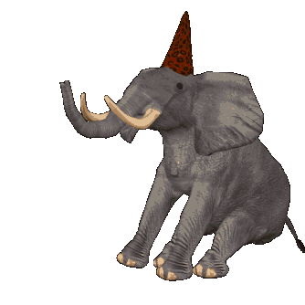
WELCOME
Notes:
This topic is about elephant so I used it greeting. Teacher also say it orally.

Slide 3


IDENTITY
SK. Md. Harunar Rashid
Senior Assist: Teacher
Sonatola Model High School,
Sonatola, Bogra.
Lesson
ENGLISH FOR TODAY
CLASS : SIX
Lesson – 7
Notes:
Teacher can hide this slide.

Slide 4
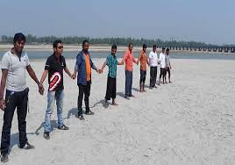
Look at the picture and describe the picture to your partner.
Holding hands
Notes:
Teacher will try to elicit the answer from the SS then he/she will give feedback by animation.

Slide 5
Today`s topic
Holding Hands
Lesson : 7

Slide 6
Learning outcomes
By the end of this lesson, students will be able to-
recognize word and stress on words in sentence.
recognize intonation in sentences.
infer meaning from context and enjoy stories and poems.

Slide 7
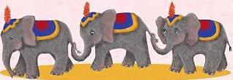

Let’s watch a video clip
Notes:
This video will be shown for students mental preparation, to practice conversation.

Slide 8
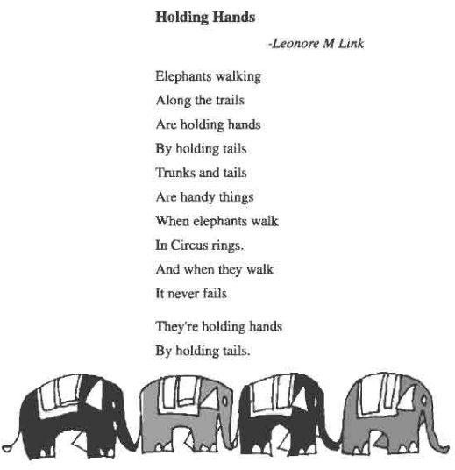
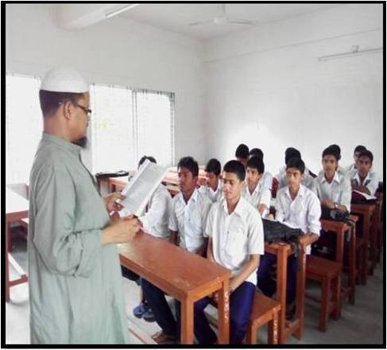
Dear students at first listen to me the poem then recite it individually and in pairs.
Notes:
Teacher can ask 2/3 pairs infornt of class for practice.

Slide 9

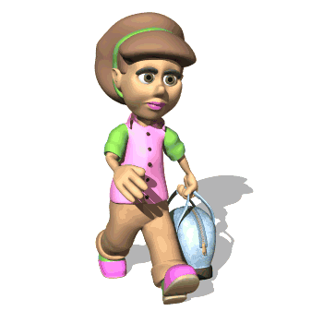
Walk
Key word
The boy is walking.
Try to say the word meaning and make sentence.
Meaning
(Click here)
March / Go forward
Notes:
First, the word can be shown. The SS can be asked to pronounce the word. If it is needed teacher can help. Then the picture can be shown and asked to guess the meaning. For feedback click on meaning.

Slide 10
Hold
Key word
Try to say the word meaning and make sentence.
They have hold their hands.
Meaning
(Click here)
Catch / Grip
Notes:
First, the word can be shown. The SS can be asked to pronounce the word. If it is needed teacher can help. Then the picture can be shown and asked to guess the meaning. For feedback click on meaning button.

Slide 11
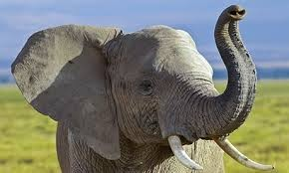
Trunk
The long nose of an elephant.
Key word
Try to say the word meaning and make sentence.
Meaning
(Click here)
The elephants hold each other by trunks and tails
Notes:
First, the word can be shown. The SS can be asked to pronounce the word. If it is needed teacher can help. Then the picture can be shown and asked to guess the meaning. For feedback click on meaning.

Slide 12
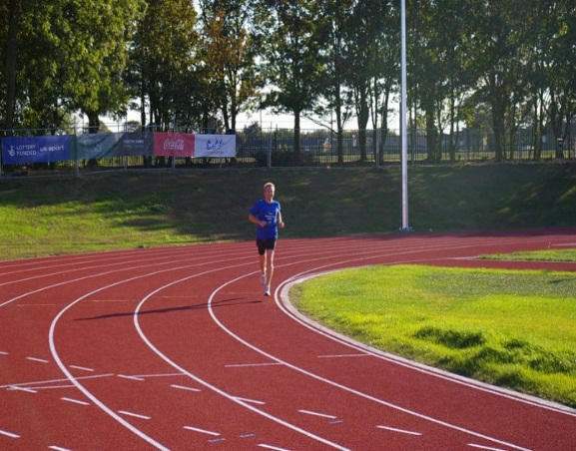
Trail
Key word
Track / Line / Path
The man is running along the trail.
Try to say the word meaning and make sentence.
Meaning
(Click here)
Notes:
First, the word can be shown. The SS can be asked to pronounce the word. If it is needed teacher can help. Then the picture can be shown and asked to guess the meaning. For feedback click on meaning.

Slide 13
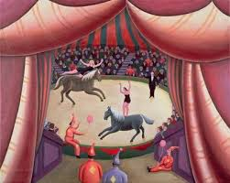
Ring
Key word
The horses are running in the ring.
A round area in which animals or people perform.
Meaning
(Click here)
Notes:
First, the word can be shown. The SS can be asked to pronounce the word. If it is needed teacher can help. Then the picture can be shown and asked to guess the meaning. For feedback click on meaning.

Slide 14
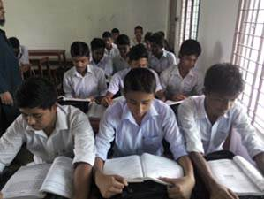
Read the poem silently
Notes:
Teacher will monitor the class and would help the students if needed.

Slide 15
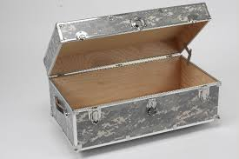
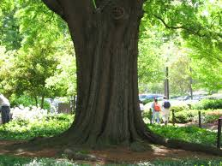


Pair works
Words | Meaning | Another meaning | More another meaning
Trunk
Ring
Look at the above words. Each word has more than one meaning. Now discuss with your friends about the other meanings of the words and try to make sentences with the words.
Notes:
Teacher can make it easy by discussing then he/she will give some time to do the meaning. Later he/she will show the next slide for feedback.

Slide 16

HOME WORK
Write three sentences with each of the words ‘trunk’ and ‘ring’.

Slide 17
Acknowledgement
We would like to express our cordial gratitude to the Ministry of Education, Directorate of Secondary & Higher Education, NCTB, a2i
and
the panel of honorable editors ( Md. Jahangir Hasan, Associate Professor (English) TTC, Rangpur, Ranjit Poddar, Associate Professor (English) TTC, Dhaka, and Urmila Ahmed, Associate Professor (English) TTC, Dhaka, to enrich the contents.

Slide 18
THE END

